Slide 1
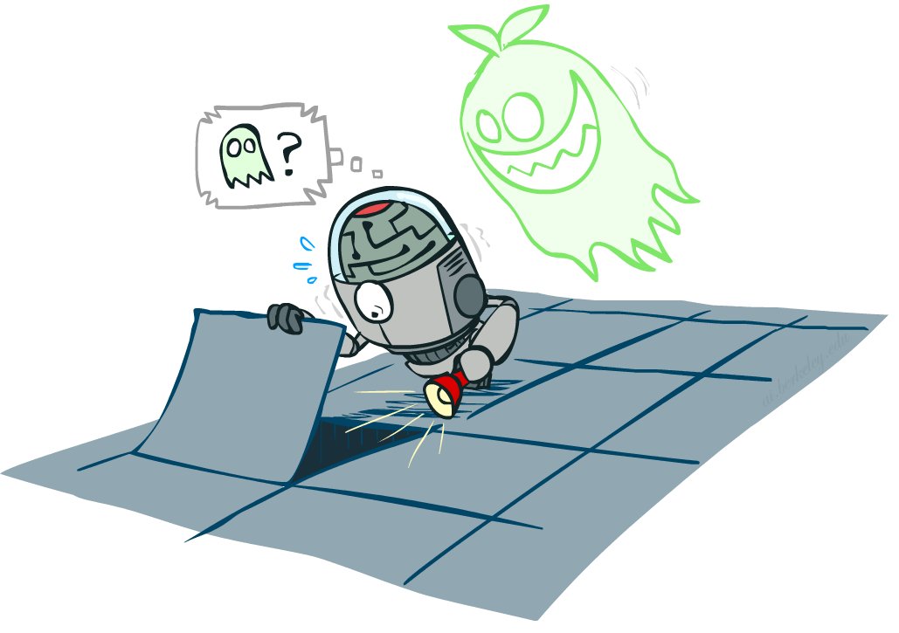
Our Status in CS188
We’re done with Part I Search and Planning!
Part II: Probabilistic Reasoning
  Diagnosis
  Speech recognition
  Tracking objects
  Robot mapping
  Genetics
  Error correcting codes
  … lots more!
Part III: Machine Learning
Notes:
Reference AI winter --- logic (exceptions, etc. + so much knowledge --- can learn)
Diagnosis: temperature, blood pressure, types of pain 🡪 disease
Speech: temporal signal of pressure variation 🡪 words and sentences
Tracking objects: e.g. helicopter you saw in last lecture, combines gps data with accelerometers, gyros and magnetic compass to infer its position and orientation using probabilistic reasoning
Robot mapping: turns out if you put a camera on the helicopter, it would not only be able to fly upside down, but also build a map of the environment!
Genetics: discovery of gene interactions from gene expression data
Error correcting codes: which we use on pretty much all our digital communication lines. They ensure that even in the presence of noise (which is everywhere) we can communicate reliably.
OK: how do we collect all that knowledge in general? --- Part III
Good news: We are going to learn about the tools that got us out of AI winter
The other news: It’s going to get very mathematical! Total shift in gears compared to what we have looked at before.
And yet other news: Time for a fresh start --- which might help if you fell behind in the past weeks.

Slide 2
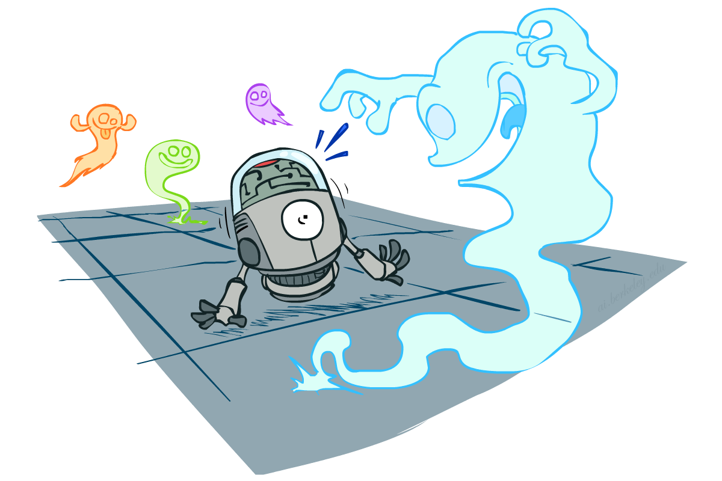
CS 188: Artificial Intelligence
Probability
Instructors: Dan Klein and Pieter Abbeel --- University of California, Berkeley
[These slides were created by Dan Klein and Pieter Abbeel for CS188 Intro to AI at UC Berkeley. All CS188 materials are available at http://ai.berkeley.edu.]
Notes:
Please retain proper attribution, including the reference to ai.berkeley.edu. Thanks!

Slide 3

Today
Probability
  Random Variables
  Joint and Marginal Distributions
  Conditional Distribution
  Product Rule, Chain Rule, Bayes’ Rule
  Inference
  Independence
You’ll need all this stuff A LOT for the next few weeks, so make sure you go over it now!
Notes:
Like “sort this list” or “add these two numbers”

Slide 4
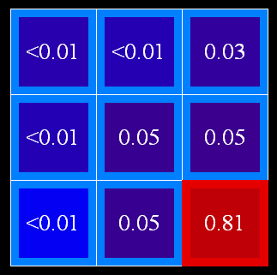
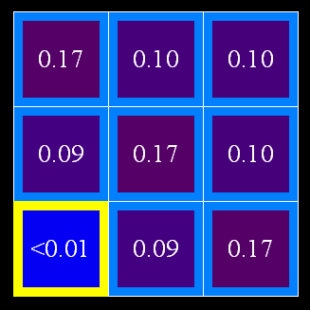
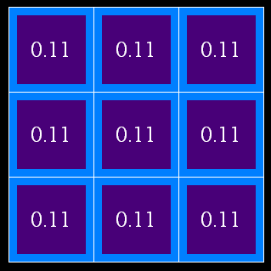
Uncertainty
General situation:
  Observed variables (evidence): Agent knows certain things about the state of the world (e.g., sensor readings or symptoms)
  Unobserved variables: Agent needs to reason about other aspects (e.g. where an object is or what disease is present)
  Model: Agent knows something about how the known variables relate to the unknown variables
Probabilistic reasoning gives us a framework for managing our beliefs and knowledge

Slide 5
Random Variables
A random variable is some aspect of the world about which we (may) have uncertainty
  R = Is it raining?
  T = Is it hot or cold?
  D = How long will it take to drive to work?
  L = Where is the ghost?
We denote random variables with capital letters
Like variables in a CSP, random variables have domains
  R in {true, false} (often write as {+r, -r})
  T in {hot, cold}
  D in [0, ∞)
  L in possible locations, maybe {(0,0), (0,1), …}

Slide 6
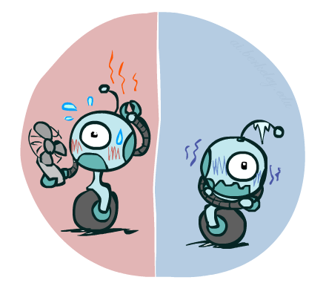

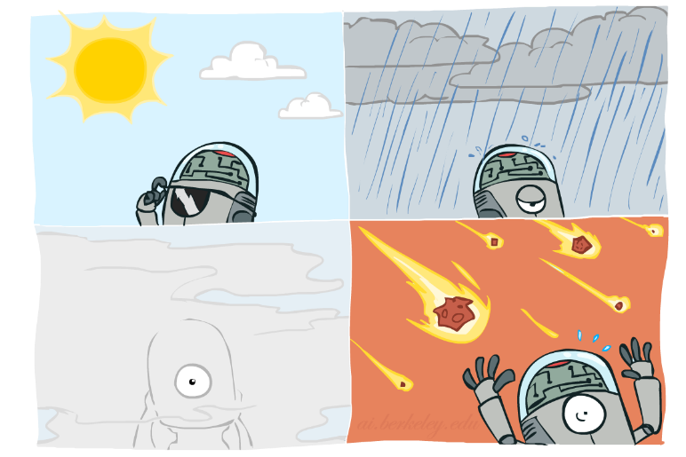

Probability Distributions
Associate a probability with each value
  Temperature:
  Weather:
W | P
sun | 0.6
rain | 0.1
fog | 0.3
meteor | 0.0
T | P
hot | 0.5
cold | 0.5

Slide 7
Probability Distributions
A statistical function that describes possible values and likelihoods that a random variable can take within a given range
The mathematical function that gives the probabilities of occurrence of different possible outcomes for an experiment
A TABLE of probabilities of values
T | P
hot | 0.5
cold | 0.5
W | P
sun | 0.6
rain | 0.1
fog | 0.3
meteor | 0.0

Slide 8


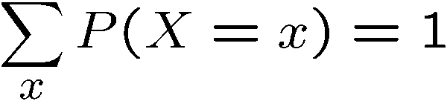
Probability Distributions
Unobserved random variables have distributions
A distribution is a TABLE of probabilities of values
A probability is a single number
Must have: and
Shorthand notation:
T | P
hot | 0.5
cold | 0.5
W | P
sun | 0.6
rain | 0.1
fog | 0.3
meteor | 0.0

Slide 9




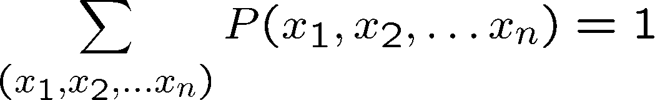
Joint Distributions
A joint distribution over a set of random variables:
specifies a real number for each assignment (or outcome):
  Must obey:
Size of distribution if n variables with domain size d?
  For all but the smallest distributions, impractical to write out!
T | W | P
hot | sun | 0.4
hot | rain | 0.1
cold | sun | 0.2
cold | rain | 0.3

Slide 10


Probabilistic Models
Distribution over T,W
A probabilistic model is a joint distribution over a set of random variables
Probabilistic models:
  (Random) variables with domains
  Assignments are called outcomes
  Joint distributions: say whether assignments (outcomes) are likely
  Normalized: sum to 1.0
  Ideally: only certain variables directly interact
Constraint satisfaction problems:
  Variables with domains
  Constraints: state whether assignments are possible
  Ideally: only certain variables directly interact
T | W | P
hot | sun | 0.4
hot | rain | 0.1
cold | sun | 0.2
cold | rain | 0.3
Constraint over T,W
T | W | P
hot | sun | T
hot | rain | F
cold | sun | F
cold | rain | T

Slide 11
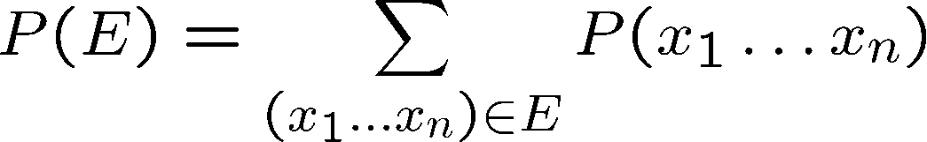
Events
An event is a set E of outcomes
From a joint distribution, we can calculate the probability of any event
  Probability that it’s hot AND sunny?
  Probability that it’s hot?
  Probability that it’s hot OR sunny?
Typically, the events we care about are partial assignments, like P(T=hot)
T | W | P
hot | sun | 0.4
hot | rain | 0.1
cold | sun | 0.2
cold | rain | 0.3

Slide 12

Quiz: Events
P(+x, +y) ?
P(+x) ?
P(-y OR +x) ?
X | Y | P
+x | +y | 0.2
+x | -y | 0.3
-x | +y | 0.4
-x | -y | 0.1

Slide 13
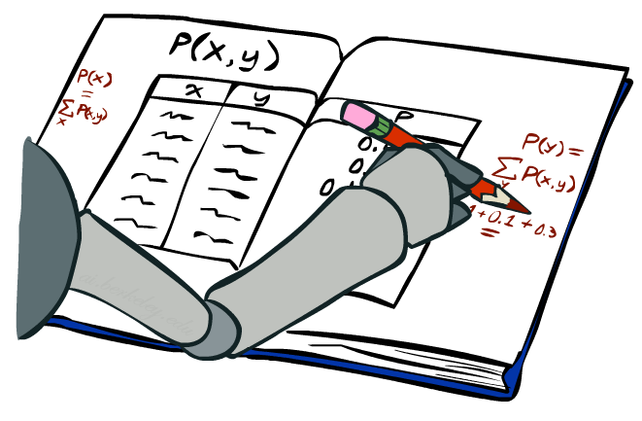
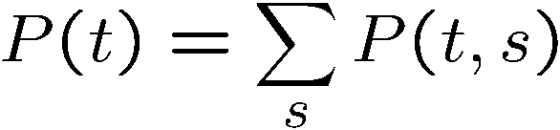
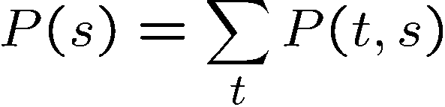
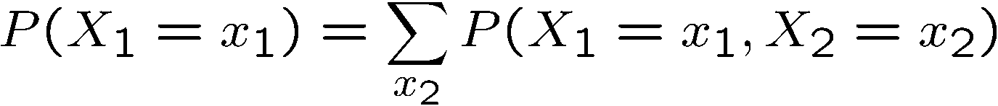
Marginal Distributions
Marginal distributions are sub-tables which eliminate variables
Marginalization (summing out): Combine collapsed rows by adding
T | P
hot | 0.5
cold | 0.5
T | W | P
hot | sun | 0.4
hot | rain | 0.1
cold | sun | 0.2
cold | rain | 0.3
W | P
sun | 0.6
rain | 0.4

Slide 14


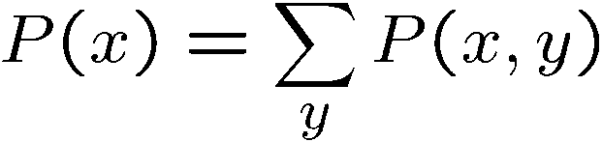

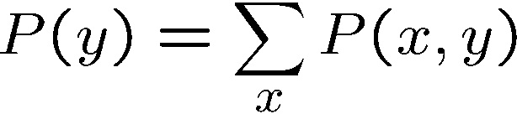
Quiz: Marginal Distributions
X | P
+x
-x
X | Y | P
+x | +y | 0.2
+x | -y | 0.3
-x | +y | 0.4
-x | -y | 0.1
Y | P
+y
-y

Slide 15
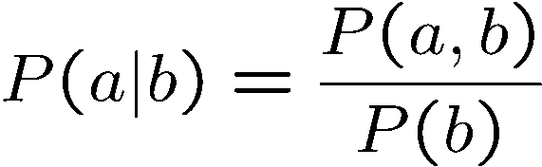
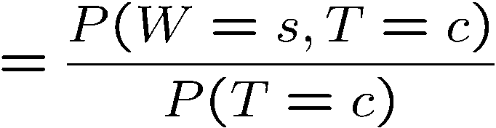
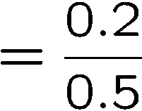



Conditional Probabilities
A simple relation between joint and conditional probabilities
  In fact, this is taken as the definition of a conditional probability
P(a,b)
P(a)
P(b)
T | W | P
hot | sun | 0.4
hot | rain | 0.1
cold | sun | 0.2
cold | rain | 0.3

Slide 16
Quiz: Conditional Probabilities
P(+x | +y) ?
P(-x | +y) ?
P(-y | +x) ?
X | Y | P
+x | +y | 0.2
+x | -y | 0.3
-x | +y | 0.4
-x | -y | 0.1

Slide 17



Conditional Distributions
Conditional distributions are probability distributions over some variables given fixed values of others
Conditional Distributions
Joint Distribution
W | P
sun | 0.8
rain | 0.2
T | W | P
hot | sun | 0.4
hot | rain | 0.1
cold | sun | 0.2
cold | rain | 0.3
W | P
sun | 0.4
rain | 0.6

Slide 18
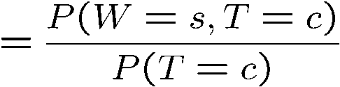

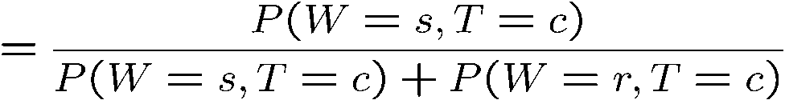
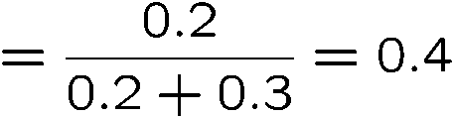

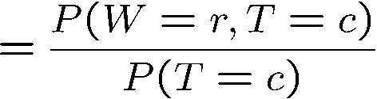

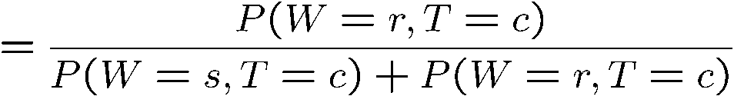
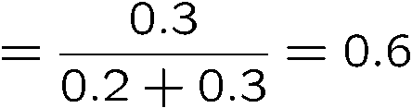
Normalization Trick
T | W | P
hot | sun | 0.4
hot | rain | 0.1
cold | sun | 0.2
cold | rain | 0.3
W | P
sun | 0.4
rain | 0.6

Slide 19








Normalization Trick
  SELECT the joint probabilities matching the evidence
  NORMALIZE the selection
  (make it sum to one)
T | W | P
hot | sun | 0.4
hot | rain | 0.1
cold | sun | 0.2
cold | rain | 0.3
T | W | P
cold | sun | 0.2
cold | rain | 0.3
W | P
sun | 0.4
rain | 0.6

Slide 20
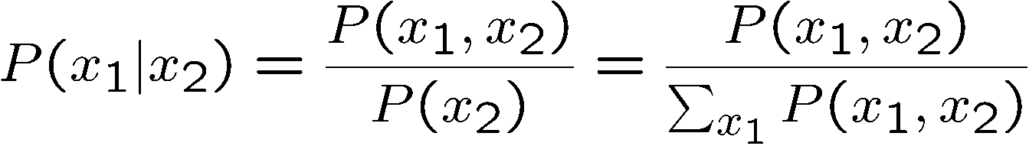
Normalization Trick
  SELECT the joint probabilities matching the evidence
  NORMALIZE the selection
  (make it sum to one)
T | W | P
hot | sun | 0.4
hot | rain | 0.1
cold | sun | 0.2
cold | rain | 0.3
T | W | P
cold | sun | 0.2
cold | rain | 0.3
W | P
sun | 0.4
rain | 0.6
Why does this work? Sum of selection is P(evidence)! (P(T=c), here)

Slide 21

Quiz: Normalization Trick
P(X | Y=-y) ?
  SELECT the joint probabilities matching the evidence
  NORMALIZE the selection
  (make it sum to one)
X | Y | P
+x | +y | 0.2
+x | -y | 0.3
-x | +y | 0.4
-x | -y | 0.1

Slide 22
To Normalize
(Dictionary) To bring or restore to a normal condition
Procedure:
  Step 1: Compute Z = sum over all entries
  Step 2: Divide every entry by Z
Example 1
All entries sum to ONE
Example 2
W | P
sun | 0.2
rain | 0.3
W | P
sun | 0.4
rain | 0.6
T | W | P
hot | sun | 20
hot | rain | 5
cold | sun | 10
cold | rain | 15
T | W | P
hot | sun | 0.4
hot | rain | 0.1
cold | sun | 0.2
cold | rain | 0.3
Normalize
Normalize
Z = 0.5
Z = 50

Slide 23


Normalization Trick
A trick to get a whole conditional distribution at once:
  Select the joint probabilities matching the evidence
  Normalize the selection (make it sum to one)
  Why does this work? Sum of selection is P(evidence)! (P(r), here)
T | W | P
hot | sun | 0.4
hot | rain | 0.1
cold | sun | 0.2
cold | rain | 0.3
check feedback on elms
T | R | P
hot | rain | 0.1
cold | rain | 0.3
T | P
hot | 0.25
cold | 0.75
Select
Normalize

Slide 24
Full Joint Probability Distribution
Gender(G) | Category(C) | Juice(J) | P(G,C,J)
M | S | O | 8/50
M | S | Mn | 6/50
M | S | L | 4/50
M | T | O | 3/50
M | T | Mn | 2/50
M | T | L | 2/50
F | S | O | 5/50
F | S | Mn | 7/50
F | S | L | 5/50
F | T | O | 2/50
F | T | Mn | 4/50
F | T | L | 2/50
Juice bar survey:
8 male students, 5 female students, 3 male teachers and 2 female teachers bought orange juice
6 male students, 7 female students, 2 male teachers and 4 female teachers bought mango juice
4 male students, 5 female students, 2 male teachers and 2 female teachers bought lemon juice

Slide 25
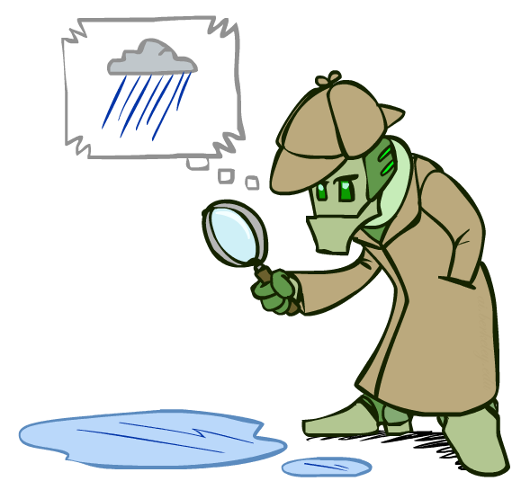
Probabilistic Inference
Probabilistic inference: compute a desired probability from other known probabilities
(e.g., conditional from joint)
We generally compute conditional probabilities
  P(on time | no reported accidents) = 0.90
  These represent the agent’s beliefs given the evidence
Probabilities change with new evidence:
  P(on time | no accidents, 5 a.m.) = 0.95
  P(on time | no accidents, 5 a.m., raining) = 0.80
  Observing new evidence causes beliefs to be updated

Slide 26





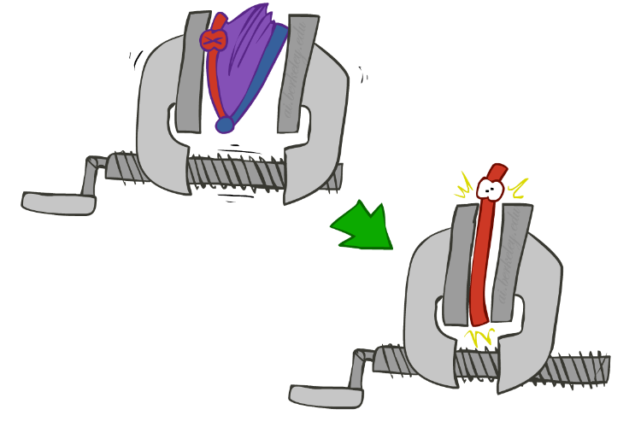
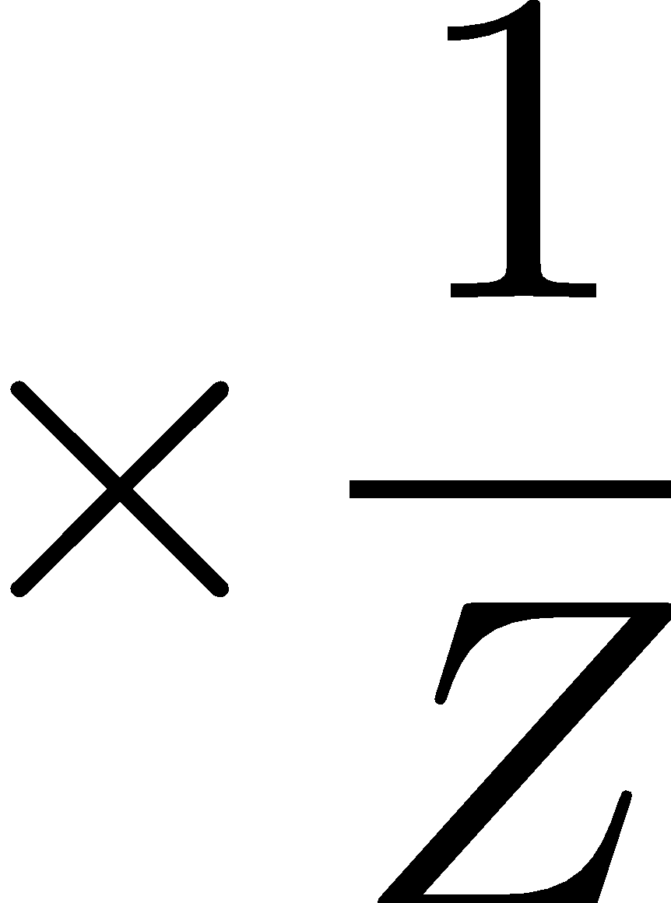
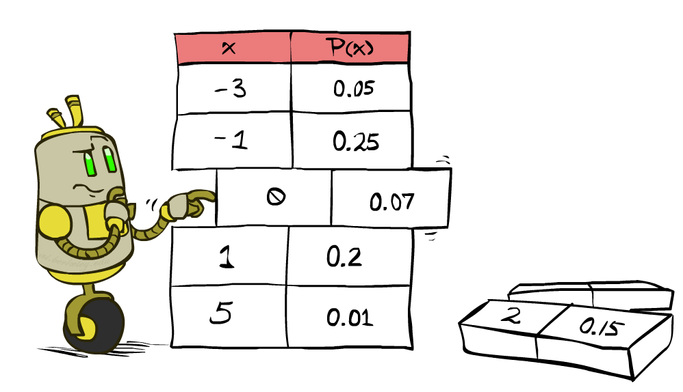


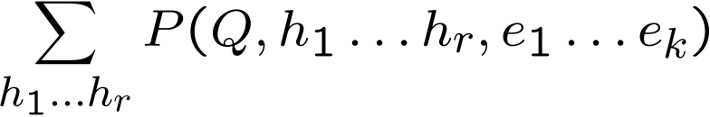
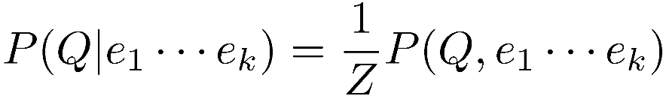
Inference by Enumeration
* Works fine with multiple query variables, too
General case:
  Evidence variables:
  Query* variable:
  Hidden variables:
We want:
All variables
Step 1: Select the entries consistent with the evidence
Step 2: Sum out H to get joint of Query and evidence
Step 3: Normalize

Slide 27
Inference by Enumeration
P(W)?
P(W | winter)?
P(W | winter, hot)?
S | T | W | P
summer | hot | sun | 0.30
summer | hot | rain | 0.05
summer | cold | sun | 0.10
summer | cold | rain | 0.05
winter | hot | sun | 0.10
winter | hot | rain | 0.05
winter | cold | sun | 0.15
winter | cold | rain | 0.20

Slide 28
Inference by Enumeration
Obvious problems:
  Worst-case time complexity O(d^{n})
  Space complexity O(d^{n}) to store the joint distribution

Slide 29
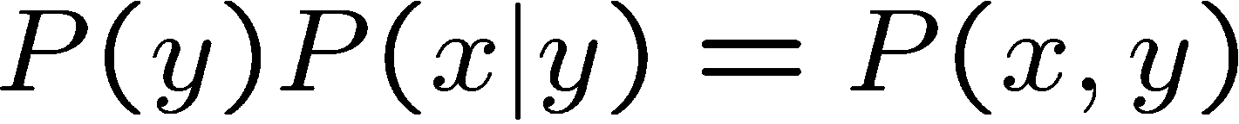
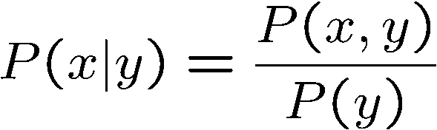
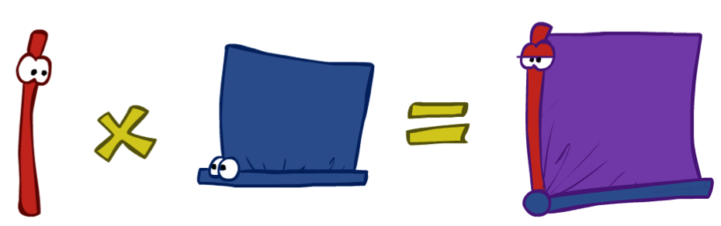
The Product Rule
Sometimes have conditional distributions but want the joint

Slide 30


The Product Rule
Example:
D | W | P
wet | sun | 0.1
dry | sun | 0.9
wet | rain | 0.7
dry | rain | 0.3
D | W | P
wet | sun | 0.08
dry | sun | 0.72
wet | rain | 0.14
dry | rain | 0.06
R | P
sun | 0.8
rain | 0.2

Slide 31
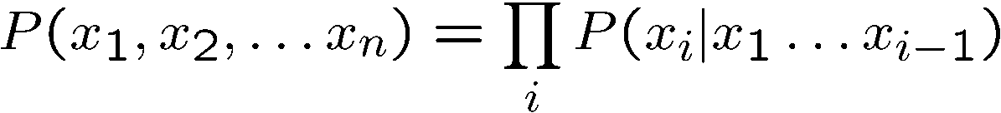
The Chain Rule
More generally, can always write any joint distribution as an incremental product of conditional distributions

Slide 32
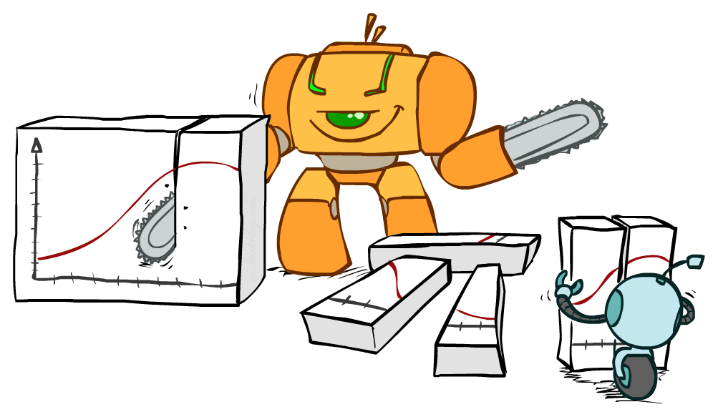
Bayes Rule

Slide 33


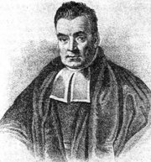
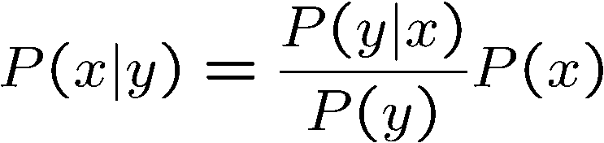
Bayes’ Rule
Two ways to factor a joint distribution over two variables:
Dividing, we get:
Why is this at all helpful?
  Let’s build one conditional from its reverse
  Often one conditional is tricky but the other one is simple
  Foundation of many systems we’ll see later (e.g., ASR, MT)
In the running for the most important AI equation!
That’s my rule!

Slide 34
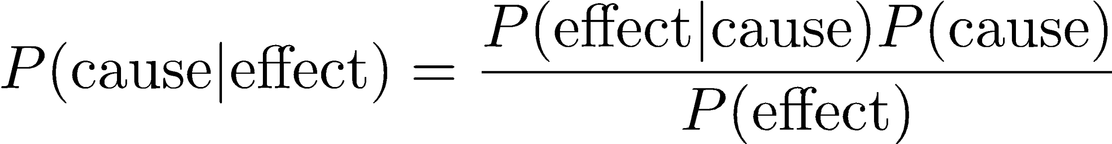

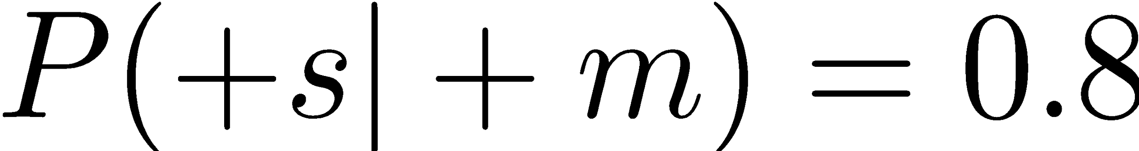

Inference with Bayes’ Rule
Example: Diagnostic probability from causal probability:
Example:
  M: meningitis, S: stiff neck
  Note: the posterior probability of meningitis is still very small
  Note: you should still get stiff necks checked out! Why?
Example
givens

Slide 35
Quiz: Bayes’ Rule
Given:
What is P(W | dry) ?
D | W | P
wet | sun | 0.1
dry | sun | 0.9
wet | rain | 0.7
dry | rain | 0.3
R | P
sun | 0.8
rain | 0.2

Slide 36
